Slide 1
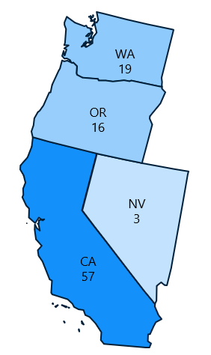

Chartis Center for Burnout Solutions | AONL Quick Hit | Q2 2026
75%
predict LPN/LVN utilization will stay the same or increase
over the next 2 years
LPNs/LVNs: A Workforce Lever Nurse Leaders Are Ready to Pull
3 out of 4 nurse leaders anticipate maintaining or expanding LPN/LVN utilization, despite persistent implementation barriers.
1 in 3 expect an increase
Respondents (June 2026):
827
representing
374
245
79%
Nurse Leaders
Hospitals
Health Systems
Magnet-Designated
PERCEIVED BARRIERS TO LPN/LVN INTEGRATION ACROSS CARE SETTINGS
TOP 5 BARRIERS TO LPN/LVN
INTEGRATION ACROSS CARE SETTINGS
IMPORTANCE OF LPN/LVN ROLE IN ACUTE CARE DELIVERY MODEL BY ROLE
TOP WAYS MEMBERS WANT AONL TO HELP
50%
Disagree
Neither Agree nor Disagree
Agree
86% of members want
AONL to take action
Role clarity, delegation, team workflow challenges (67%)
Scope of practice limitations (65%)
Training, onboarding, or supervision capacity (27%)
Difficulty recruiting or retaining LPNs/LVNs (24%)
Quality or patient safety concerns (13%)
Top 3 ways members want AONL’s support:
25%
Best practice guidance (67%)
Engage Magnet Commission on evolving care models (28%)
Thought leadership – being the trusted expert for nursing leadership (28%)
0%
Nursing leadership preference
Internal philosophical views
Medical
staff concerns
Magnet-
related considerations
"They are also nurses. Their voice deserves to be heard."
Members Voices
"We allow LPNs to work at the top of their license,
carefully choosing care areas where they can be utilized to their fullest."
Most
REGIONAL VARIATIONS:
Region 9
Regions 3 & 6
Region 5
WHERE THEY WORK
63% reported collective bargaining influences LPN/ LVN deployment – about twice the overall average.
Highest concentration of barriers: role clarity and scope of practice.
Acute Care
Ambulatory
Emergency Department
Post-Acute Care
Most influential regional factors to LPN/LVN integration
Highest agreement that state policy drives LPN/LVN integration.
% utilization
Least
LPN/LVN Employment in Ambulatory or Primary Care
Organizations’ Support for Formal LPN-RN Career Pathways
Yes, with tuition support but no formal academic partnership | 43%
Yes, dedicated funding and formal bridge partnership | 36%
No formal pathways | 14%
Informal support only | 7%

